Slide 1
Bloom
Beauty
Makeup e-commerce Website

Slide 2
About Us
02
Welcome to our makeup shop! Meet Bloom Beauty our dedicated makeup enthusiast. With a passion for enhancing natural beauty, Bloom Beauty has mastered the art of makeup transformations. Their expertise covers a range of looks, from everyday elegance to red carpet glamour. Count on us for personalized advice and recommendations, as they guide you through our high-quality products. Let us help you discover the perfect shades and finishes to express your unique style. Step into our shop and experience the expertise of our makeup guru.

Slide 3

Brand Style guide
Name & Logo:
BloomBeauty
www.reallygreatsite.com

Slide 4
Brand Style guide
Typography
Primary font
Secondary font
Arapey
Segoe UI
ABCDEFGHIJKLMNOPQRSTUVWXYZ
ABCDEFGHIJKLMNOPQRSTUVWXYZ
abcdefghijklmnopqrstuvwxyz
abcdefghijklmnopqrstuvwxyz
0123456789
0123456789
www.reallygreatsite.com

Slide 5
Brand Style guide
Font - Inter
Heading 1
Heading 2
Heading 3
Heading 4
Heading 5
Heading 6
Font size
55 px
48 px
40 px
32 px
24 px
20 px
Line Height
61.6 px
52.8 px
44 px
35.2 px
26.4 px
22 px
40 px
www.reallygreatsite.com

Slide 6





Brand Style guide
Colors theory
#FCC822
100%
#111
100%
#222
100%
#fff
100%
#000
100%
www.reallygreatsite.com

Slide 7
05
Business model canvas

Slide 8
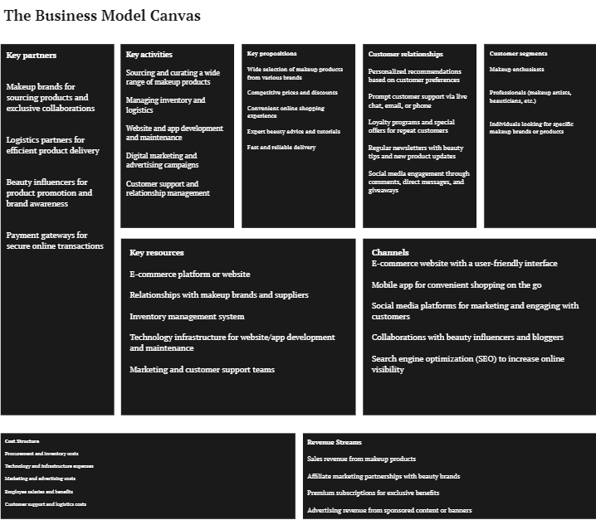

Slide 9

Thank you

